Slide 1
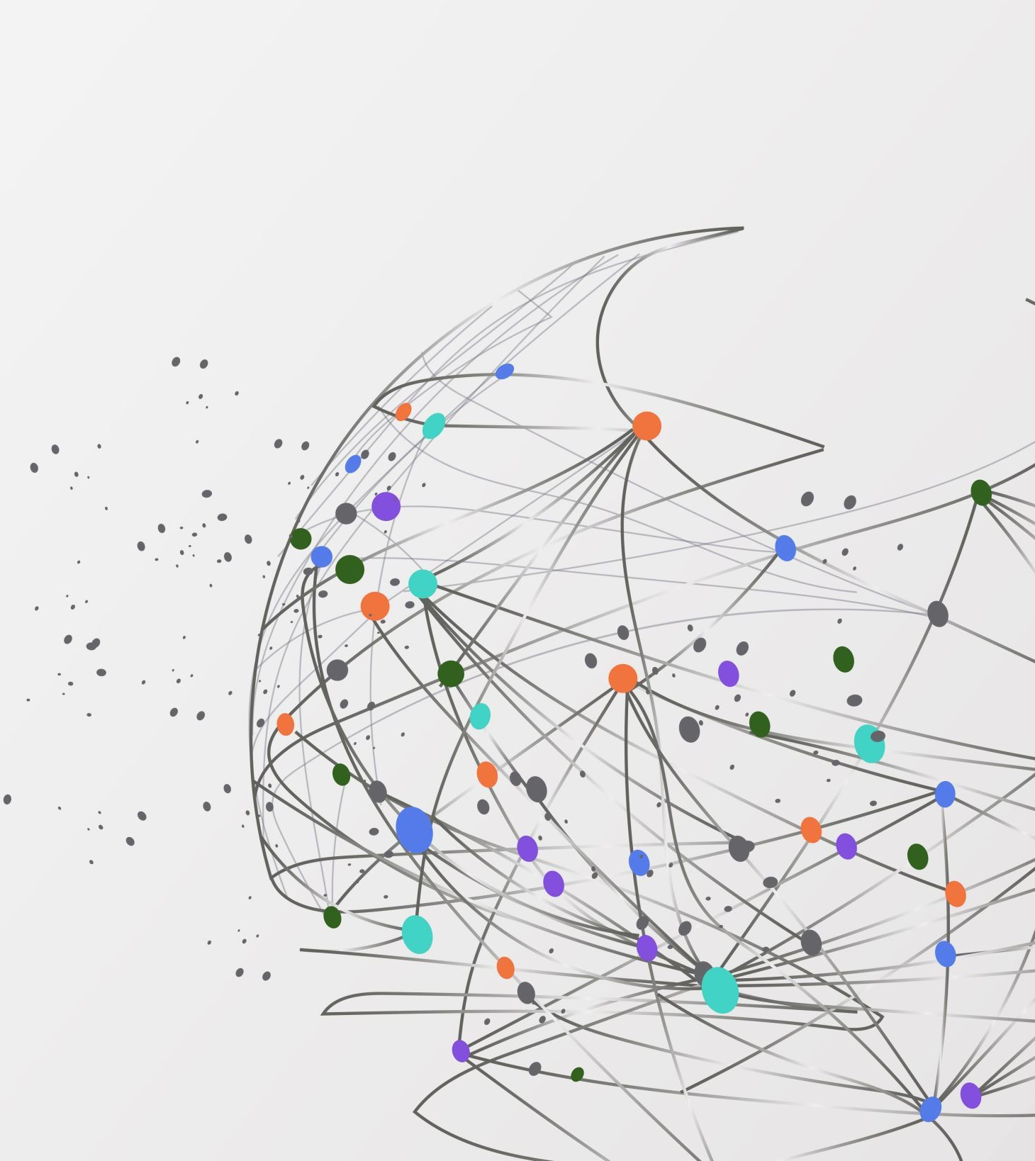
COVID19 Detection from Chest X-Ray Images using OpenCV and CNN
CS385-Mini Project
Biswajit Sarkar-2101AI11

Slide 2
Problem Statement and Objective
The COVID-19 pandemic has strained healthcare systems worldwide. Efficient identification of COVID-19 patients is crucial for timely treatment and containment.
Develop a deep learning model to differentiate COVID-19 patients from others using chest X-ray images.
Explore the COVID-19 Radiography Database to train and evaluate the model.
Achieve high accuracy and reliability in COVID-19 detection to aid medical professionals.

Slide 3
Methodology
Data Collection: Utilized the COVID-19 Radiography Database, containing chest X-ray images labeled with four categories: Normal, COVID, Lung Opacity, and Viral Pneumonia.
Preprocessing: Using OpenCV to Grayscale conversion, resizing, and normalization of images to prepare them for model training.
Model Architecture: Implemented a Convolutional Neural Network (CNN) comprising multiple layers: Convolutional layers with ReLU activation , Max pooling layers for down sampling , Dropout layers for regularization , and Dense layers for classification.
Training and Evaluation: Compiled the model using categorical cross-entropy loss and the Adam optimizer and trained the model and measured accuracy and generated a confusion matrix for performance analysis.

Slide 4
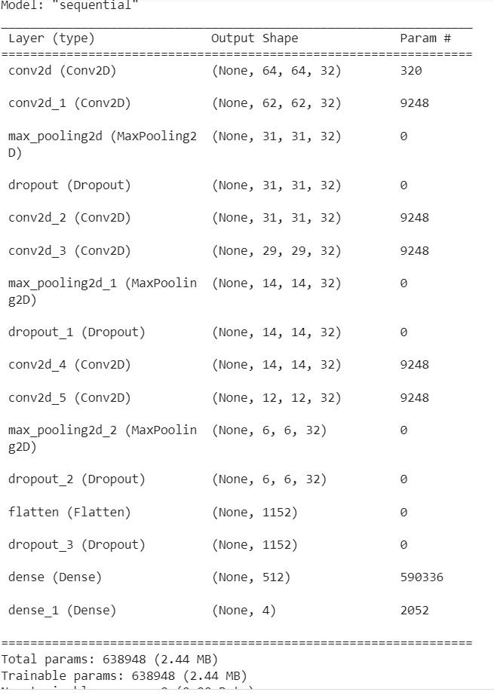
Model Architecture

Slide 5
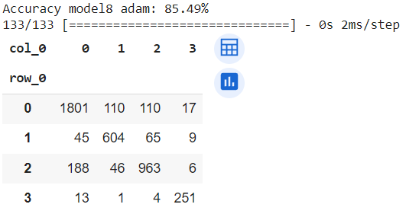
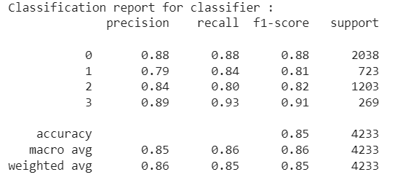
Preliminary Results

Slide 6
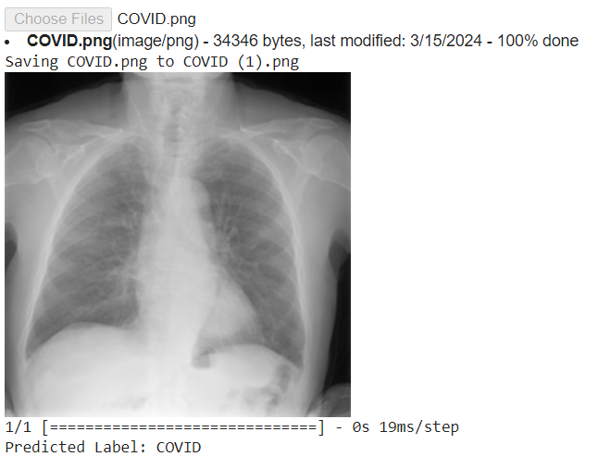
Prediction

